Slide 1
TESTING PRINCIPLES

Slide 2

Seven Principles of Software Testing
EXHAUSTIVE TESTING IS NOT POSSIBLE
DEFECT CLUSTERING
PESTICIDE PARADOX
TESTING SHOWS A PRESENCE OF DEFECTS
EARLY TESTING
TESTING IS CONTEXT DEPENDENT
ABSENCE OF ERROR - FALLACY

Slide 3
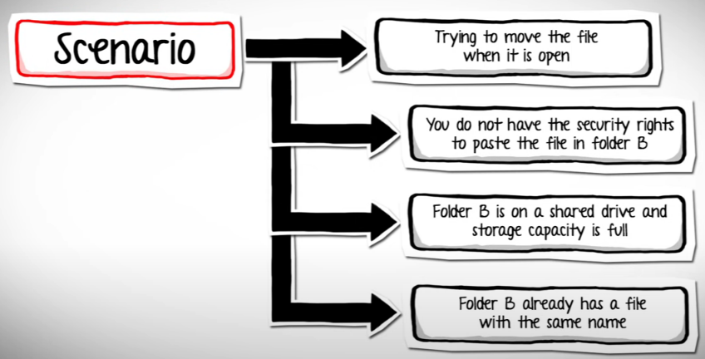

Slide 4
1. EXHAUSTIVE TESTING IS NOT POSSIBLE
TESTING ALL THE FUNCTIONALITIES WITH VALID AND INVALID COMBINATIONS OF INPUT DATA DURING ACTUAL TESTING IS IMPOSSIBLE.
THEREFORE, TESTING OF A FEW COMBINATIONS IS DONE BASED ON PRIORITY USING DIFFERENT TECHNIQUES.

Slide 5
A Website has 4 pages, 3 menus with 2 options each.
Option has 5 fields, 2 types of inputs each fields.
Each input type has 50 possible values.
The total test conditions for exhaustive testing

Slide 6
A Website has 4 pages, 3 menus with 2 options each.
Option has 5 fields, 2 types of inputs each fields.
Each input type has 50 possible values.
The total test conditions for exhaustive testing
4 pages * 3 menus * 2 options * 5 fields * 2 types * 50 values = 30,000 tests

Slide 7
2. DEFECT CLUSTERING
IN A PROJECT, A SMALL NUMBER OF MODULES CONTAIN MOST OF THE DEFECTS DETECTED.
THIS IS THE APPLICATION OF THE PARETO PRINCIPLE TO SOFTWARE TESTING (80-20 RULE)
80% OF ISSUES COMES FROM 20% OF MODULES AND
REMAINING 20% OF ISSUES FROM REMAINING 80% OF MODULES.

Slide 8
80% of work is completed by 20% of your team There is often a wide performance gap between your top performers and the rest of the team.
80% of customers only use 20% of software features Most users don't use power features as they find power features to be annoying

Slide 9
3. PESTICIDE PARADOX
IF YOU EXECUTE THE SAME SET OF TEST CASES AGAIN AND AGAIN OVER THE PERIOD OF TIME THESE SET OF TEST CASES CANNOT IDENTIFY NEW DEFECTS IN THE SYSTEM.
SO TO OVERCOME THIS PESTICIDE PARADOX, IT IS NECESSARY TO REVIEW THE TEST CASES REGULARLY AND ADD OR UPDATE THEM TO FIND MORE DEFECTS.

Slide 10
Repetitive use of the same pesticide mix to destroy insects during farming over the time lead to the insects developing resistance to the pesticide, Thereby making thereby pesticides ineffective on insects
The same applies to software testing

Slide 11
4. TESTING SHOWS A PRESENCE OF DEFECTS
TESTING TALKS ABOUT THE PRESENCE OF DEFECTS & DON’T TALK ABOUT THE ABSENCE OF DEFECTS
SOFTWARE TESTING CAN ENSURE THAT DEFECTS ARE PRESENT, BUT IT CAN NOT PROVE THAT SOFTWARE IS DEFECTS FREE.
EVEN MULTIPLE TESTING CAN NEVER ENSURE THAT SOFTWARE IS 100% BUG-FREE.

Slide 12
An application might seem to be error-free after going through different stages of testing.
But during the production in the environment, the user may come across any defect which did not occur during the testing.

Slide 13
5. EARLY TESTING
TESTING NEEDS TO BE PERFORMED ON REQUIREMENT DOCUMENTS, SPECIFICATION OR ANY OTHER TYPE OF DOCUMENT.
SO THAT IF REQUIREMENTS ARE INCORRECTLY DEFINED THEN IT CAN BE FIXED IMMEDIATELY RATHER THAN FIXING THEM IN THE DEVELOPMENT PHASE.
THE COST INVOLVED IN FIXING SUCH DEFECTS IS VERY LESS WHEN COMPARED TO THOSE THAT ARE FOUND DURING THE LATER STAGES OF TESTING.

Slide 14
Assume two scenarios, first is identifying an incorrect requirement in the requirement gathering phase and the second is identifying a bug in the fully developed functionality.

Slide 15
Assume two scenarios, first is identifying an incorrect requirement in the requirement gathering phase and the second is identifying a bug in the fully developed functionality.
It is cheaper to change the incorrect requirement compared to fixing the fully developed functionality which is not working as intended

Slide 16
6. TESTING IS CONTEXT DEPENDENT
ALL THE DEVELOPED SOFTWARE’S ARE NOT IDENTICAL.
DIFFERENT DOMAINS ARE TESTED DIFFERENTLY.
THUS, TESTING IS PURELY BASED ON THE CONTEXT OF THE SOFTWARE.

Slide 17
Testing any POS system at a retail store will be different than testing an ATM machine

Slide 18
7. ABSENCE OF ERROR - FALLACY
IF THE SOFTWARE IS TESTED FULLY AND NO DEFECTS ARE FOUND BEFORE RELEASE, THEN YOU CAN CONSIDER THE SOFTWARE TO BE 99% DEFECT-FREE.
BUT IF THE SOFTWARE IS TESTED AGAINST WRONG REQUIREMENTS, THEN IT IS UNSTABLE.
SO, SOFTWARE WHICH WE BUILT NOT ONLY BE A 99% BUG-FREE , BUT ALSO IT MUST FULFIL THE BUSINESS NEEDS OTHERWISE IT WILL BECOME AN UNUSABLE SOFTWARE.

Slide 19
Testing an application related to an e-commerce site and the requirements against “Shopping Cart” functionality is wrongly interpreted and tested.
Finding more defects would not help in moving the application into the next phase or in the production environment.

Slide 20
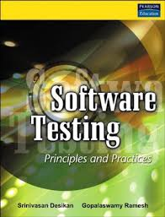



REFERENCES

